Slide 1
vCommunity sourced best practices for upgrading vSphere with vSAN and NSX
By @arielsanchezmor
V1.1

Slide 2
You can find this PPT and any source code in blogs.arielsanchezmora.com
Or tweet @arielsanchezmor

Slide 3
Agenda
- About me and disclaimers
1. Software and time
2. The 3 layers – vSphere, vSAN, NSX
3. General upgrade strategies
4. Community resources
- Supporting slides
- Q&A and stickers!

Slide 4
A favor
Take a pic during this session. Tweet it out with #KCVMUG
I really like interacting with people in Twitter and the #vCommunity – send me any thoughts from today, your cat pictures and your blog posts!

Slide 5
A bit about me
Costa Rican in Orlando
Sr TAM @VMware, CTO Ambassador
Advocate of the vCommunity (vBrownBag crew, vExpert, VMUG, VTUG, vBeers, vBrisket…)
I started using Twitter in 2013 for VMW
I want to help other people present at VMUG!
vExpert PRO – I’ll help you prepare for vExpert

Slide 6
BIG disclaimer slide
Notice, no VMware logos anywhere
This is purely a community session I geeked up
I am a VMware fanboy though
I think it’s important that we share stories and tips and who in the vCommunity is a great resource for vSphere + vSAN + NSX

Slide 7
Interactive session!!
This is a two way street – participation encouraged! I’m not an expert in everything
If you see something wrong or I missed critical info, please let me and the room know, this community is here to help each other!
Don’t leave any question unasked!
We are the vCommunity, share and blog!

Slide 8
1. Software and time
Who has heard of “Lifecycle Policies”?
a) General Support
The General Support phase begins on the date of general availability of a Major Release (“GA”) and lasts for a fixed duration. During the General Support phase, for customers who have purchased VMware support, VMware offers maintenance updates and upgrades, bug and security fixes, and technical assistance as per the Support and Subscription Terms and Conditions.

Slide 9
1. Software and time
b) Technical Guidance Phase
Technical Guidance, if available, is provided from the end of the General Support phase and lasts for a fixed duration. Technical Guidance is available primarily through the self-help portal and telephone support is not provided. Customers can also open a support request online to receive support and workarounds for low-severity issues on supported configurations only. During the Technical Guidance phase, VMware does not offer new hardware support, server/client/guest OS updates, new security patches or bug fixes unless otherwise noted.

Slide 10
1. Software and time
End of Support Life (EOSL)
A product has reached its end of support life when it is no longer generally supported by VMware. End of support life for a specific product is either end of General Support or end of Technical Guidance, if available for that specific product.

Slide 11
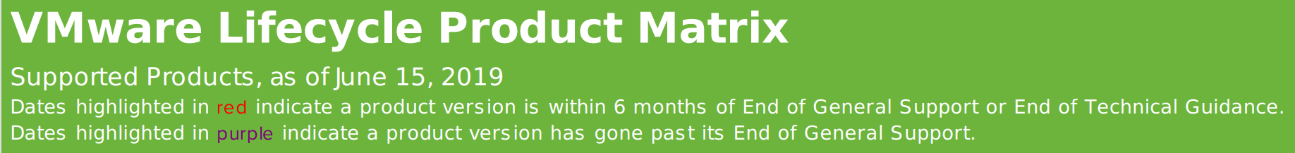
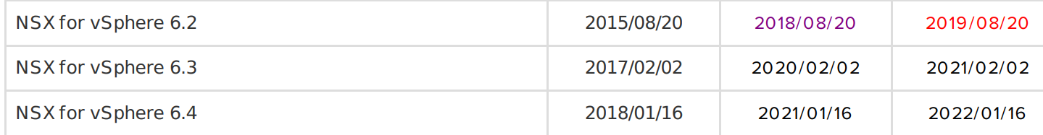
1. Software and time
VMware Lifecycle Product Matrix
Average for ESXi, vCenter and vSAN is 5 years.
What’s the average for NSX?

Slide 12
1. Software and time
Two more thoughts:
Major dot releases introduce features
Minor dot releases include bugfixes
Products are released to work in a certain ecosystem

Slide 13
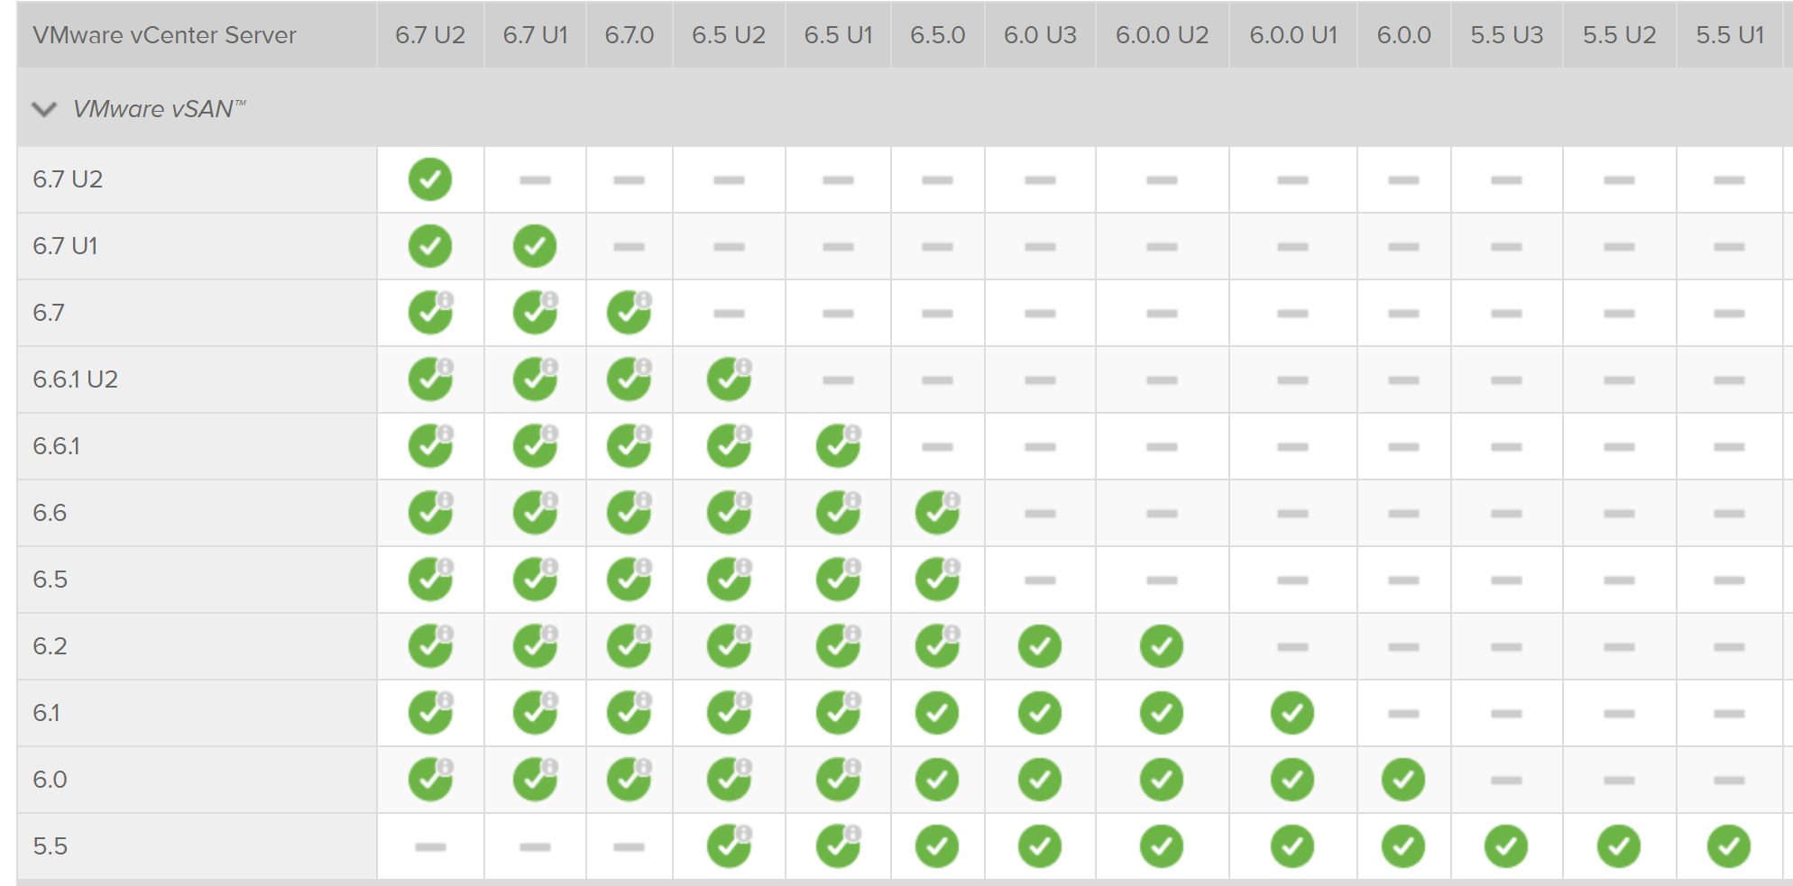
1. Software and time
VMware Interoperability Matrix

Slide 14
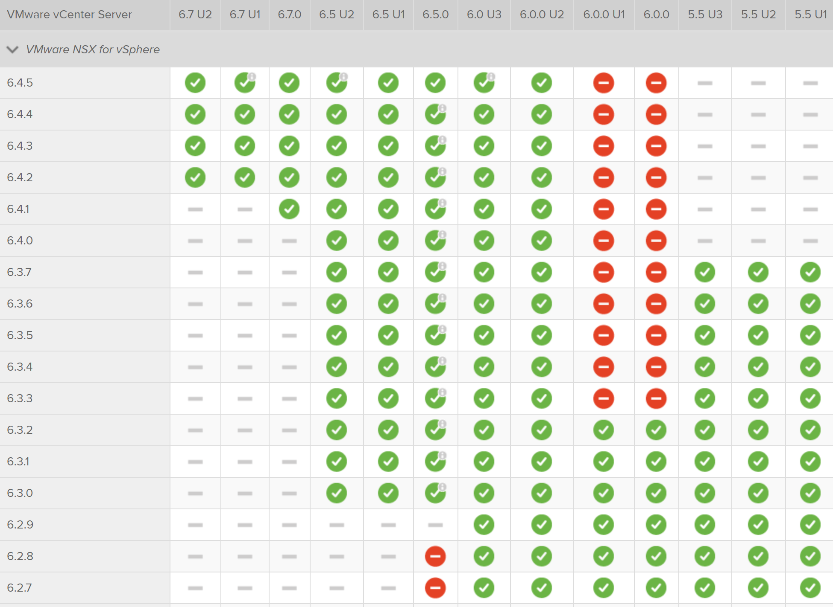
1. Software and time

Slide 15
2. The 3 layers – vSphere, vSAN, NSX
vSphere is very tolerant
vSAN showed people weren’t paying attention to the HCL (even if it was a whole new HCL)
NIC driver bugs are frequently found in NSX deployments
Your vSphere deployments have to be solid.

Slide 16
2. The 3 layers – vSphere, vSAN, NSX
The 5 main environmental reasons why I see people call in GSS (overall)
1) DNS
2) NTP
3) Certificates*
4) VCSA Root passwords or partitions full
5) HCL problems

Slide 17
2. The 3 layers – vSphere, vSAN, NSX
Use something like vDocumentation to see your environment and compare it to what you think it is!
You can get config settings through PowerCLI code, these community tools save you time. Check out #AsBuiltReport too!
Documentation is the gateway to not having nasty surprises

Slide 18
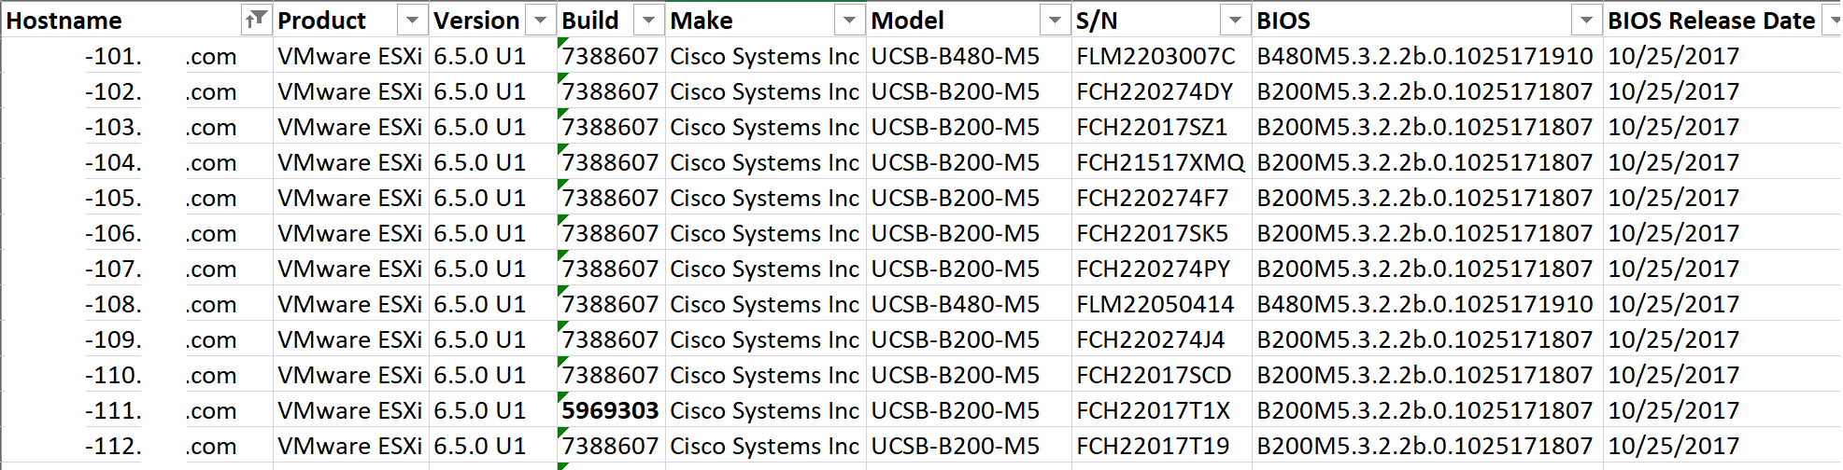
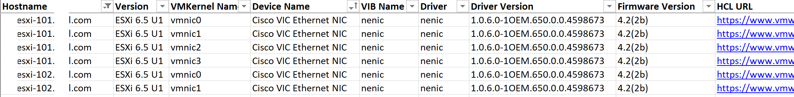
2. The 3 layers – vSphere, vSAN, NSX

Slide 19
2. The 3 layers – vSphere, vSAN, NSX
With certificates, develop a standard and apply it uniformly
This is an excellent walkthrough
Do all vSphere certs BEFORE adding the other solutions (if you can)
Keep alerts on when the new certs and any intermediate or root CAs expire!

Slide 20
2. The 3 layers – vSphere, vSAN, NSX
Always treat storage as priority one
Make sure your vCenter and hosts are healthy before attempting to add more solutions
NSX is a layer above a healthy vSphere environment
Lots of communication with different silos/users/administrators that may emerge

Slide 21
3. General upgrade strategies
Give yourself plenty of time and communicate
Make sure backups are solid and you can failback
Understand the 3rd party solution dependencies
Understand the correct order to upgrade your environment
Confirm your environment supports the upgrade
Don’t try to upgrade everything at the same time
Don’t put off patching and upgrades for too long
Read upgrade notes & get a preemptive GSS ticket

Slide 22
3. General upgrade strategies
Give yourself plenty of time and communicate
Understand who your users are and their impact
Servers just don’t reboot fast. Firmware :p
Confirm the first “completed” host is working before continuing with the rest – have test plans!
vSAN can take a lot of time depending on the maintenance mode selected (and each has consequences!) and post-upgrade resync
NSX upgrade packages can be 7GB+

Slide 23
3. General upgrade strategies
Make sure backups are solid and you can failback
Do you have a backup you can restore confidently or just a snapshot of only one part of the environment?
Have you tested restoring backups without vCenter?
Don’t snapshot external PSCs, Use the VCSA file-based backup methods instead
Understand your vSAN policy risk during an upgrade window
NSX backups are also kinda complex

Slide 24
3. General upgrade strategies
Understand the 3rd party solution dependencies
Most frequent: if you have a separate backup admin, he needs to upgrade his software before you upgrade vCenter!
Some fun 3rd party situations:
Citrix has to communicate with the cluster
The password manager software doesn’t work
You have to upgrade the AV software
Monitoring software can’t connect

Slide 25
3. General upgrade strategies
Understand the correct order to upgrade your environment
This is an awesome KB for vSphere 6.7 – 53710
vCenter is #8 of 15!
Don’t forget VMware Tools and VM Hardware!
Several add-on solutions depend on VMware Tools and modern VM HW versions, like NSX guest operations and AppDefense
NSX is before vCenter, and vSAN is LAST!

Slide 26
3. General upgrade strategies
Confirm your environment supports the upgrade
Especially if you’re bringing hardware through several upgrades, the vSphere or vSAN HCL may not support your older SSDs or controllers
You may have VM hardware and VMware tools dependencies on a subsequent upgrade for guest introspection/AV
Monitoring solutions that have management packs
Figure out if you have non-supported/legacy OS and VM HW components like Flexible NICs

Slide 27
3. General upgrade strategies
Don’t try to upgrade everything at the same time
If you have vSphere, NSX and vSAN, and you don’t have VCF/vxRail, you’re better off handling each upgrade separately
vCenter in itself can be a long upgrade if it’s not 100% healthy
Finish the hosts, firmware, HCL – making sure vSAN is in a supported state
I recommend NSX upgrades in a separate timeframe

Slide 28
3. General upgrade strategies
Don’t put off patching and upgrades for too long
If you don’t patch regularly you will not get the best and most stable code
If you don’t upgrade before time, you will have forced upgrades where several platforms have to be upgraded at the same time.
Keeping your infrastructure patched shows you are a good admin with good processes and leads to knowledge and documentation

Slide 29
3. General upgrade strategies
Read the upgrade notes & get a preemptive GSS ticket
There’s specific upgrade documentation for each product: NSX-V NSX-T vCenter ESXi vSAN
And sometimes even websites and best practice KBs vSAN NSX-V
But most of the really relevant info is in the Release Notes!
Open a pre-emptive GSS ticket, have them health check your environment and confirm your plans

Slide 30
4. Community resources
There’s not a lot of upgrade focused content, but I’ve started a GH repo so we can all collaborate as we find more.
I’ve also included people who are very knowledgeable on vSphere, vSAN and NSX
Valdecir Carvalho has a long list of vSAN resources called “Awesome vSAN”

Slide 31
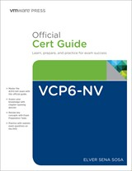
How to learn NSX-V from scratch
VCP6-NV – Elver’s book is AMAZING
There’s no substitute for hands-on
Hands on Labs (nine labs now)
NSX-V Install Configure Manage, Troubleshooting and Operations (NSX-T now has ICM as well!)
VCAP6-NV free training and free NSX ebooks
VMUG Advantage (typically discounted today)
Great NSX demo site to show co-workers

Slide 32
Supporting slides

Slide 33
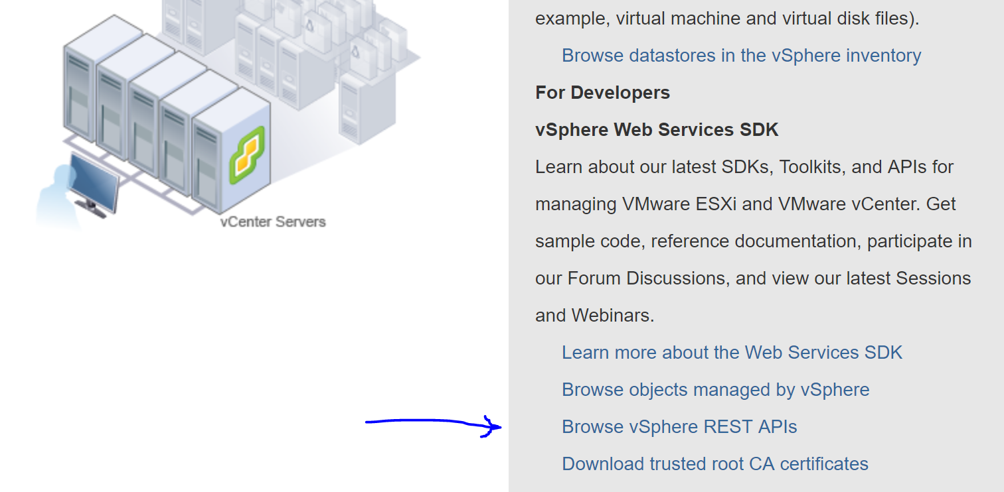
Getting started with REST APIs
https://vCenter/apiexplorer
Kyle Ruddy did an excellent vBrownBag video

Slide 34
Dev / Homelab strategy
Several vSphere hosts, with at least two vCenters or closely mimicking production
Switches that can handle increased MTU
Enough RAM to run both V and T ☺
You can find refurbished Intel DC hard drives cheaply in amazon for vSAN capacity

Slide 35
Further Reading for NSX
With NSX you really want to dig into the documentation
NSX Data Center for vSphere documentation and 6.4.4 installation guide
NSX-T Data Center documentation and 2.3 installation guide
VMTN forums are very active!

Slide 36
We’re done ☺
Please please give feedback to me
I have some ideas on what else I can do, but I want to know what you got out of it
@arielsanchezmor on Twitter or in the VMware Code Slack

Slide 37
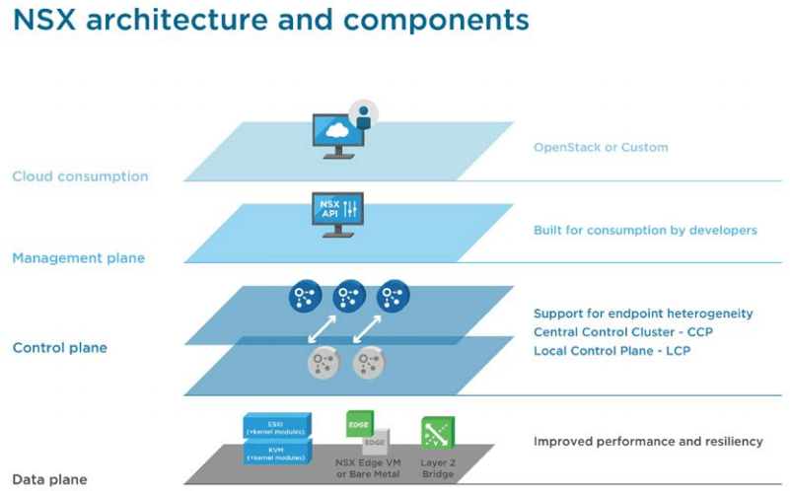
NSX Data Center for vSphere

Slide 38
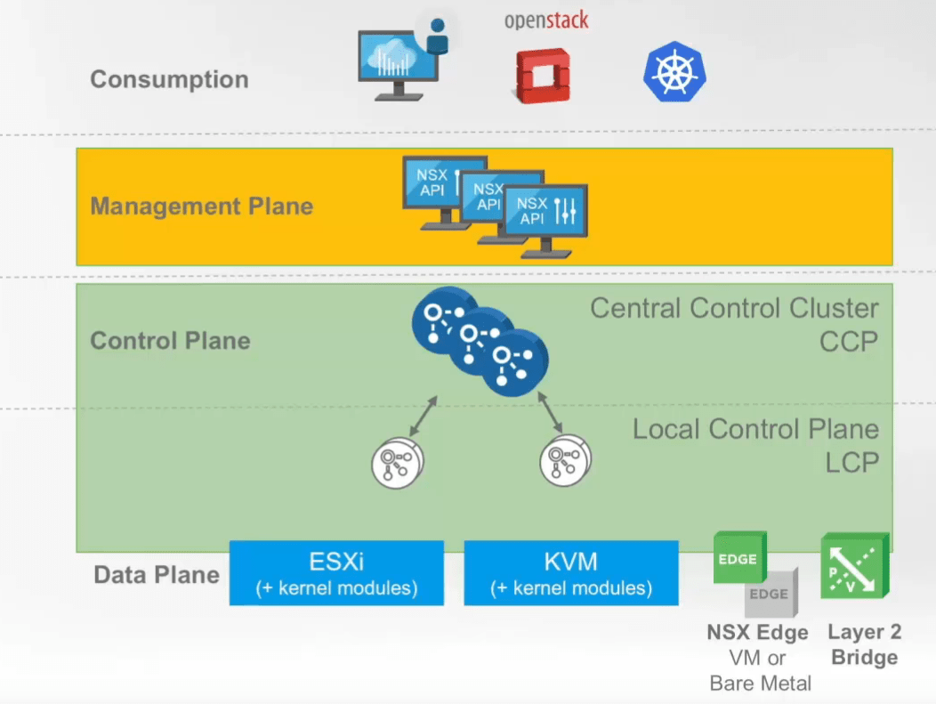
NSX-T for Data Center
Works with several Compute Managers
New N-VDS or OvS

Slide 39
NSX Differences for V and T
NSX-V = NSX Data Center for vSphere
NSX-T = NSX-T Data Center
NSX –V | NSX-T
Requires vSphere | Independent
Requires DVS | Installs N-VDS or OVN Kernel Modules
Only supports ESXi | Supports basically any Enterprise OS
Today has more features / integrations | Less amount but newer types
Can handle vSphere cases | Can handle all hybrid cloud cases

Slide 40
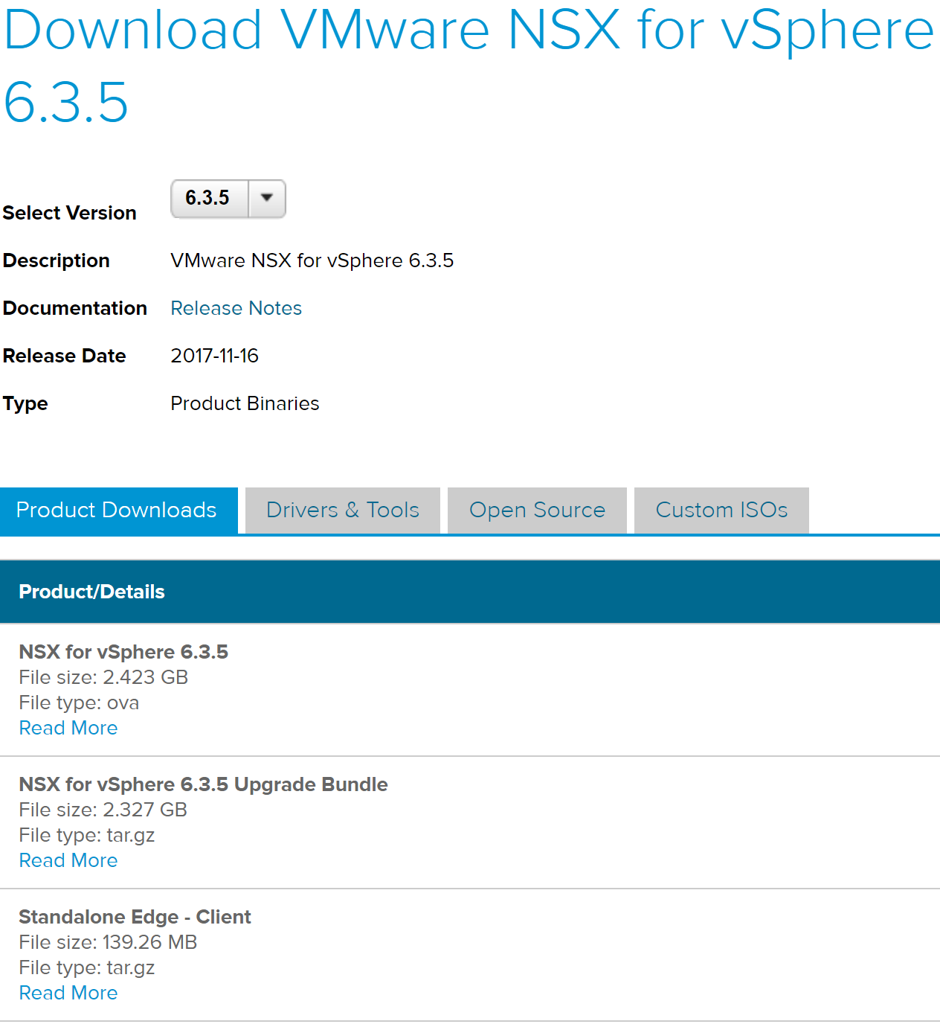
NSX Data Center for vSphere DLs

Slide 41
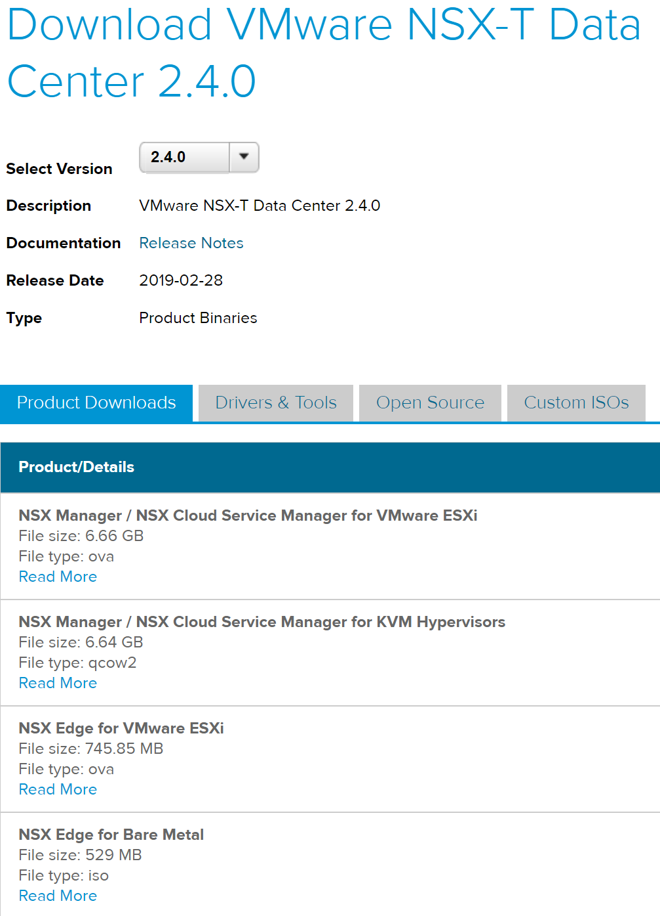
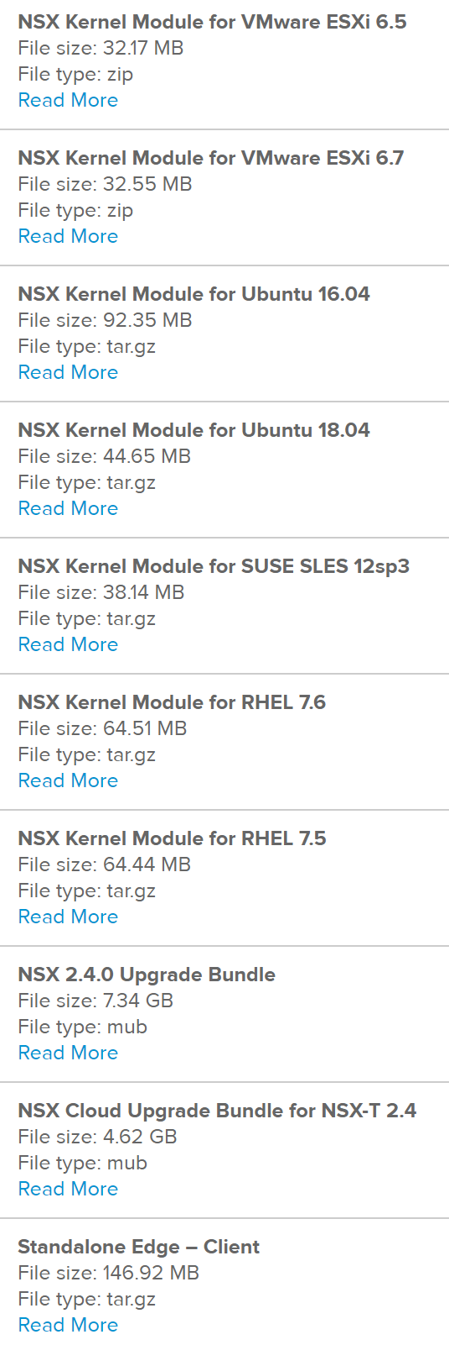
NSX-T Data Center downloads

